Slide 1
Analysis of Daily Sub-Basin-wise Rainfall Data (July 2023)
Data Source: India Meteorological Department (IMD)
M.SAI DEEKSHITHA

Slide 2
Dataset Overview
• Contains 2185 records of rainfall data.
• Covers multiple basins & sub-basins across India.
• Data for July 2023, sourced from IMD GRID MODEL.
• Includes average daily rainfall measurements.
• Some missing values in Avg_rainfall column.

Slide 3
Key Data Fields
• Basin: Major river basins in India.
• Subbasin: Subdivisions within the basins.
• Date: Daily rainfall record.
• Avg_rainfall: Rainfall amount in mm.
• Agency_name: Source - IMD GRID MODEL.

Slide 4
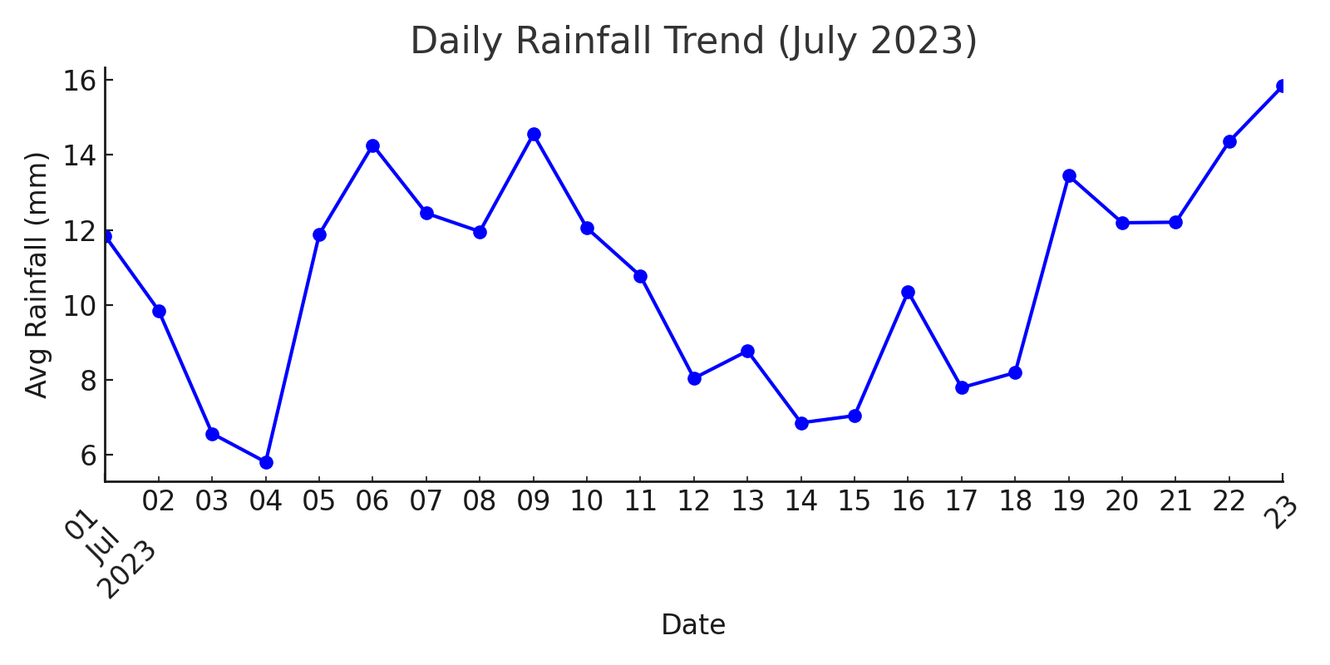
Daily Rainfall Trend (July 2023)
This graph illustrates the daily average rainfall trend across all sub-basins in July 2023.

Slide 5
• Daily rainfall varied significantly across sub-basins.
• Some regions experienced higher peaks in precipitation.
• The IMD GRID MODEL provides accurate tracking.
• Potential use for weather forecasting and planning.

Slide 6
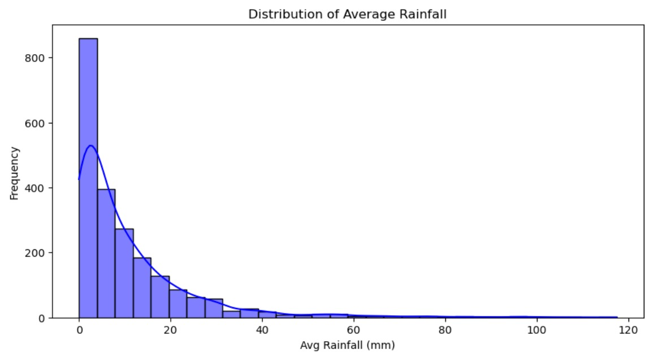
This graph illustrates the Distribution of Average Rainfall

Slide 7
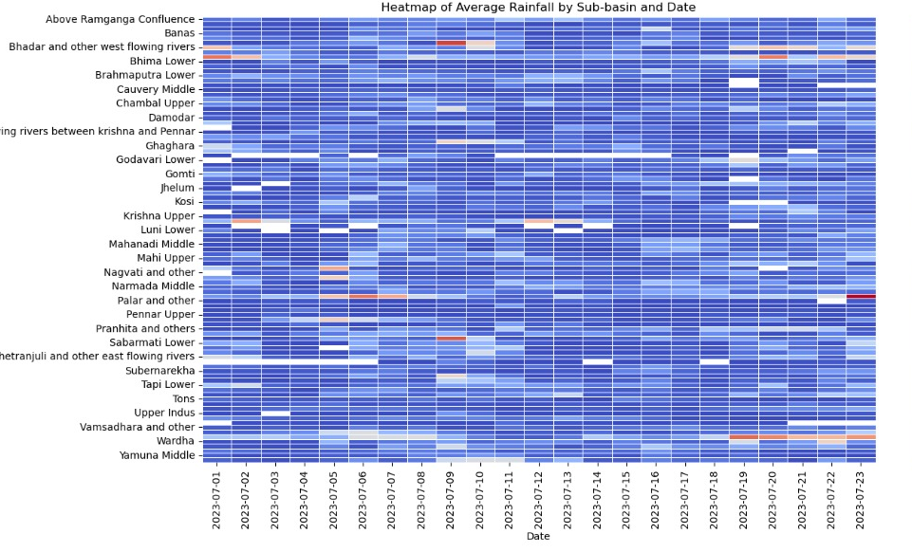
This graph illustrates the Heatmap of Average Rainfall by sub-basin and Date

Slide 8
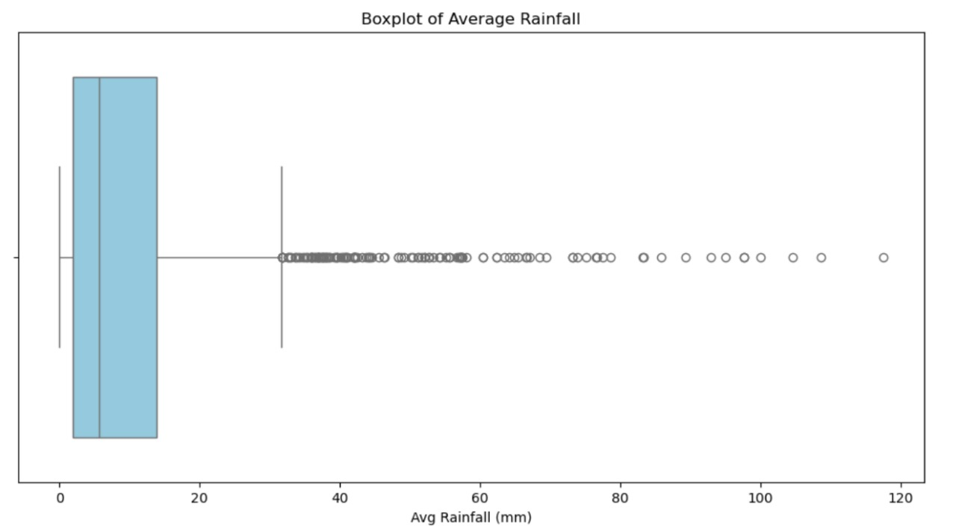
This graph illustrates the Boxplot of Average Rainfall

Slide 9
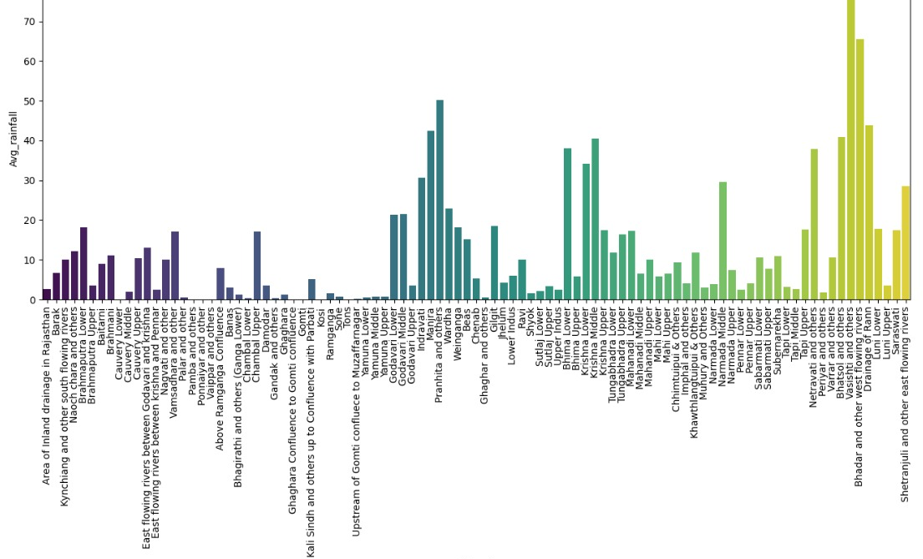
This graph illustrates the Average Rainfall of Sub-Basin

Slide 10
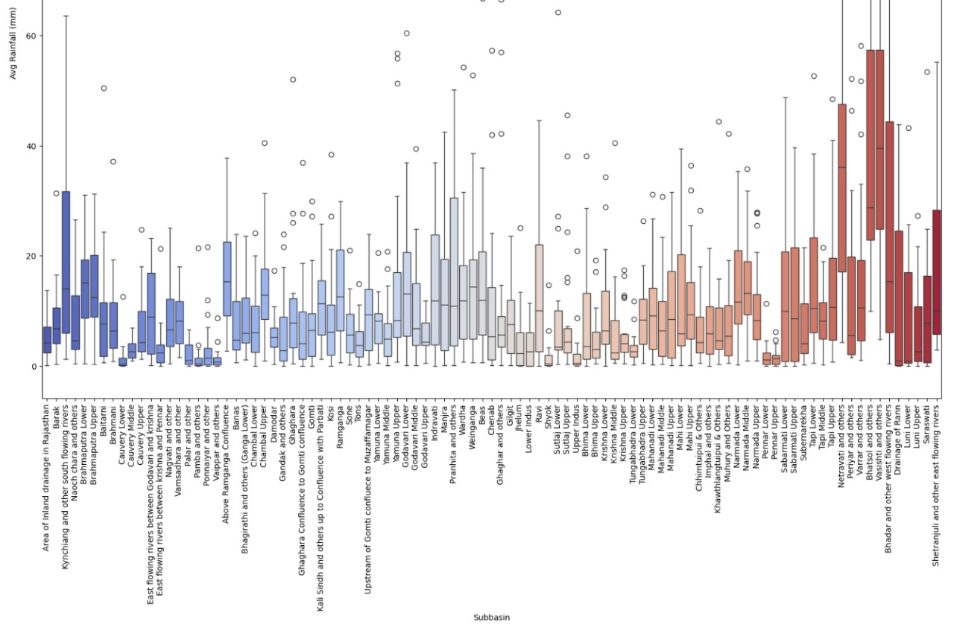
This graph illustrates the Average Rainfall Analysis

Slide 11
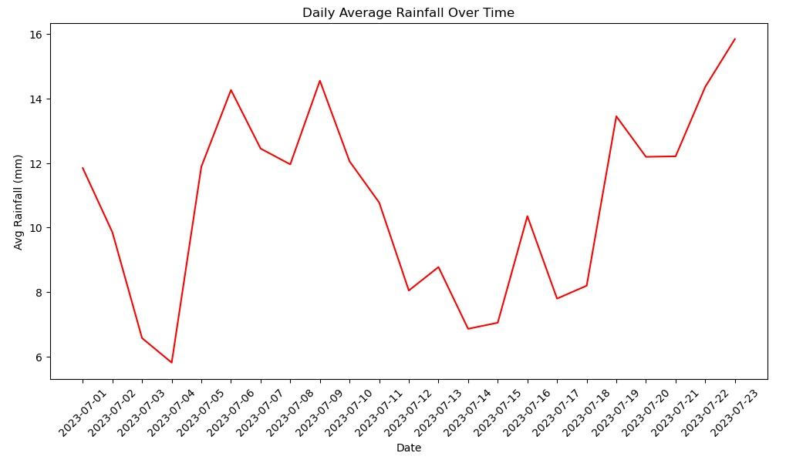
This graph illustrates the Daily Average Rainfall of Over Time

